Slide 1
Academic Writing: The Common College Essay
Kimberly Kern
English Language Fellow, IHCI
Kimberly.kern@ihcihn.com
Information from: Allen Grove- collegeapps.about.com, essayhell.com

Slide 2
Welcome back!
I hope you all gave the essay topics some thought!
Who is prepared with a draft?
Hopefully you have a strong story… now let’s talk about structure, style, tone, and mechanics!

Slide 3
The Writing Process
Brainstorm –which prompt? Which story?
First draft
Revise –structure/ did I answer the question?/ content
Second draft
Revise - style/ tone
Edit- mechanics, spelling, etc.
Third/Final draft

Slide 4
Remember…. Even if your essay is beautifully written with perfect grammar and mechanics…if you don’t have a unique story to tell, it won’t be interesting to read. Don’t start the editing process until you have a good story.

Slide 5
Structure and Content
Introduction, body, and conclusion
Anecdote, story, experience
Descriptive language
Self-analysis!!!
Every paragraph has its own topic!
Did I answer the prompt?
Is this essay unique to me?

Slide 6
Style
The style of a narrative essay is different from other essays.
It is your perspective.
We should be able to hear your voice speak through the words
Walk the line between formal and informal writing.

Slide 7
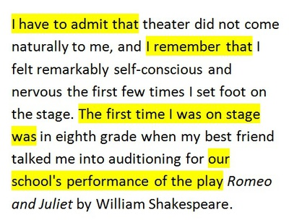
Wordiness and Repetition

Slide 8
Cut the filler!
"Theater did not come naturally to me, and I felt remarkably self-conscious and nervous the first few times I set foot on stage in the eighth grade. My best friend had talked me into auditioning for Shakespeare's Romeo and Juliet."

Slide 9
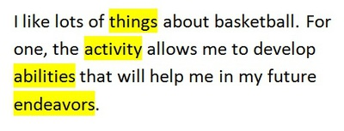
Vague and Imprecise Language

Slide 10
Be Specific!
"Not only do I find basketball fun, but the sport has helped me develop my leadership and communication skills, as well as my ability to work with a team. As a result, my love of basketball will make me a better business major."

Slide 11
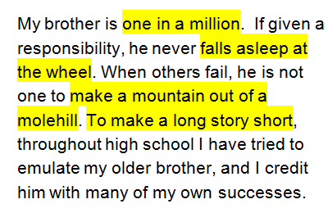
Cliches

Slide 12
Don’t use them. They’re boring.
"Throughout high school, I have tried to emulate my brother. He takes his responsibilities seriously, yet he is generous when dealing with the shortcomings of others. This combination of reliability and graciousness makes others turn to him for leadership. My own successes in high school are due largely to my brother's example."

Slide 13
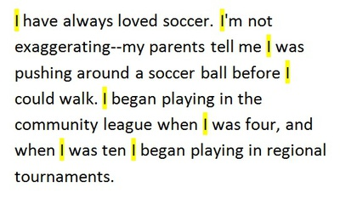
Overuse of “I”

Slide 14
Also use my and me!
"Soccer has been a part of my life for longer than I can remember. Literally. My parents have photos of me crawling around as a baby pushing a ball with my head. My later childhood was all about soccer -- the community league at age four, and participation in regional tournaments by ten."

Slide 15
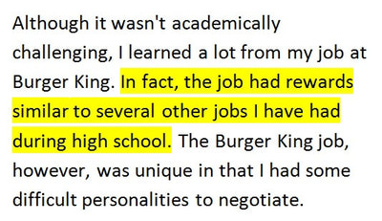
Digression

Slide 16
Stay on topic! Less is more!
Although it wasn't academically challenging, I learned a lot from my job at Burger King because I was forced to negotiate some difficult personalities."

Slide 17
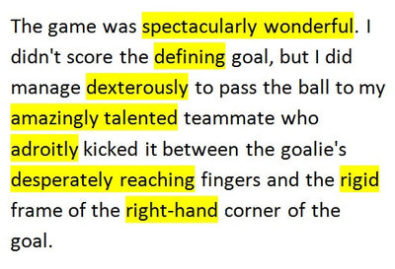
Flowery Language

Slide 18
Be Clear, not Melodramatic
"The game was close. I won't receive credit for our win, but I did pass the ball to my teammate who scored the winning goal. He received the praise for kicking the ball into the narrow space between the goalie's hands and the upper corner of the goal post, but the victory was really about a team, not an individual."

Slide 19
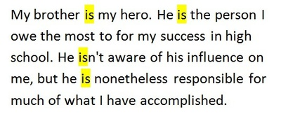
Weak Verbs

Slide 20
Use strong verbs
"More than anyone else, my brother deserves credit for my achievements in high school. I can trace my successes in academics and music back to my brother's subtle influence."

Slide 21
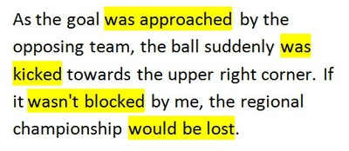
Passive Voice

Slide 22
Active voice is more interesting
"As the opposing team approached the goal, a striker kicked the ball towards the upper right corner. If I didn't block it, my team would lose the regional championship."

Slide 23
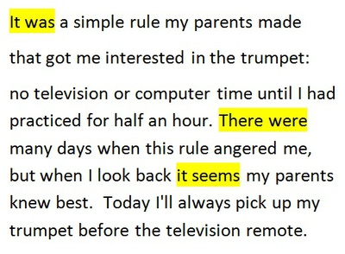
Expletive Constructions

Slide 24
Use interesting verbs!
"My parents made a simple rule that got me interested in the trumpet: no television or computer time until I had practiced for half an hour. This rule often angered me, but when I look back I know my parents knew best. Today I'll always pick up my trumpet before the television remote."

Slide 25
Tone
Tone is the writer’s attitude toward the subject (audience)
The tone can be sad, excited, humorous, mysterious
Diction -the words we choose to express ourselves- formal or slang?
It is strange that the professor had not assigned any papers for three weeks.
It's strange that the professor hadn't assigned any papers for three weeks."

Slide 26
Tone
Point of view- this essay should be first person!!
Syntax- the way we put words together in a sentence (rules!)
I like cheese pizza.
subject, verb, adjective, object
Level of formality- your essay should walk the line between formal and informal. Remember your audience, but be yourself.

Slide 27
Revision Checklist
Does the essay have a clear and concise main idea? Is this idea made clear to the reader early in the essay (usually in the introduction)?
Does the introduction create interest in the topic and make your audience want to read on?
Is there a clear plan and sense of organization to the essay? Does each paragraph develop logically from the previous one?
Is each paragraph clearly related to the main idea of the essay? Is there enough information in the essay to support the main idea?

Slide 28
Revision Checklist
Is the main point of each paragraph clear? Is each point adequately and clearly defined and supported with specific details?
Are there clear transitions from one paragraph to the next? Have key words and ideas been given proper emphasis in the sentences and paragraphs?
Are the sentences clear and direct? Can they be understood on the first reading? Are the sentences varied in length and structure?
Are the words in the essay clear and precise? Does the essay maintain a consistent tone?
Does the essay have an effective conclusion--one that emphasizes the main idea and provides a sense of completeness?

Slide 29
Mechanics
Proofread your essay! More than once!
Stick with the same verb tense in a paragraph! Self analysis should be in present tense!
Use English spell check!
Use a blank line between each paragraph. No need for indentation.

Slide 30
Editing Checklist
Is each sentence clear and complete?
Can any short, choppy sentences be improved by combining them?
Can any long, awkward sentences be improved by breaking them down into shorter units and recombining them?

Slide 31
Editing Checklist
Can any wordy sentences be made more concise?
Can any run-on sentences be more effectively coordinated or subordinated?
Does each verb agree with its subject?
Are all verb forms correct and consistent?

Slide 32
Editing Checklist
Do pronouns refer clearly to the appropriate nouns?
Do all modifying words and phrases refer clearly to the words they are intended to modify?
Is each word in the essay appropriate and effective?
Is each word spelled correctly?
Is the punctuation correct? Don’t use dashes if you don’t know how!

Slide 33
Last tip!
Read your essay out loud!
Sometimes your ears can find mistakes that your eyes miss. It should be easy to read without stopping to go back and re-read!
You want the admissions officers to enjoy the experience of reading your essay!

Slide 34
Now…
Use this time to re-read your draft and make any changes. Content first!
Read it to a friend… or
Exchange essays with a friend
You may send me your essays to read, but I would like a third draft! Not a first draft.
Kimberly.kern@ihcihn.com
Kern.kimika@gmail.com

