Slide 1
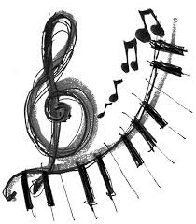
USINg music to engage language learners
Kimberly Kern
English Language Fellow 2014
IHCI, Honduras

Slide 2
“Music is the universal language of mankind” henry wadsworth longfellow

Slide 3
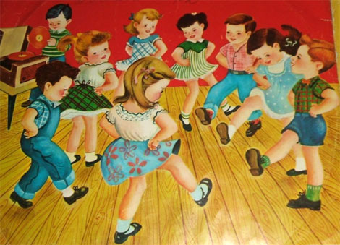
Hokey pokey
Warm Up- TPR with Music

Slide 4
You put your right foot in,
you put your right foot out,
you put your right foot in,
and you shake it all about!
You do the hokey pokey
and you turn yourself around.
That’s what it’s all about! (clap)
Right foot, left foot, right arm, left arm, right elbow, left elbow, head, right hip, left hip, whole self,
back side

Slide 5
Why use music in the classroom? Research shows music…
Improves concentration
Improves memory
Makes learning fun
Helps students absorb material
Motivates learning
Brings a sense of community
Relaxes people who are stressed
Encourages multiple learning styles

Slide 6
Today we will look at…
Receptive language skills:
Active listening activities
Active reading activities
Expressive Language Skills
Speaking/ pronunciation activities
Writing activities
Grammar
Cultural/historical awareness
American culture and expressions/ idioms
World history and world cultures

Slide 7
ACTive Listening
Listen once and write any words; listen again for more new words
Close activity
Match the phrases
Specific details
Listening for “gist” or main idea
Arrange song lyrics in order as they listen to the song repeatedly.

Slide 8
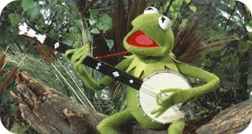
Listen for specific details
Listen to “Rainbow Connection” by Kermit the Frog.
How many times does he say “rainbow”?

Slide 9
Active Reading
Close activity: insert words that make sense in context
Using "authentic” lyrics: search for main idea, theme, details.
Research interpretations of songs and compare and contrast analysis
Read about an artist or group
Ex: The Beatles
Read about the history
or genre of music
Ex: Jazz, Pop, Rock, Rap

Slide 10
Songfacts.com
Read this paragraph about the historical and geographical context of “Penny Lane.”
Paul McCartney was sitting at a bus shelter waiting for John Lennon to meet him on Penny Lane, a street near their houses. While sitting there Paul jotted down the things he saw, including a barber's shop with pictures of its clients and a nurse selling poppies for Remembrance Day (November 11th or the day World War 1 officially ended). He later turned these into the song we now know. Penny Lane still contains the bank and barber's shop mentioned in the song.
Is there a good “people watching” place in your city?

Slide 11
Songmeanings.com
Read this interpretation of the song’s lyrics. Do you agree?
"In Penny Lane there is a barber showing photographs of ev’ry head he’s had the pleasure to know. And all the people that come and go stop and say ‘Hello’." He keeps a set of photos of everyone famous he's met, like an autograph book. Not too out there, but still strange behavior. The ordinary people of Penny Lane/Liverpool want to be near greatness, so they participate in the oddity, and stop in to look at the photos of people they'll never be.

Slide 12
Speaking
Braintorm about the topic of the song
Sing and/or act out a song.
Groups explain the lyrics of a song
Karaoke at the end of class!
Work on specific pronunciation.
Discuss the emotions of songs/genres
Students create questions related to the song and discuss

Slide 13
Example: IHCI 3rd graders perform a Christmas Song

Slide 14
Example: IHCI access students perform for valentines day

Slide 15
Writing
Summarize a song.
Create their own lyrics using a grammar pattern
Classroom theme song
Student “songbooks”.
Personal feelings/emotions
Translate a favorite song
Write interpretations to a song- what is it REALLY about?

Slide 16
If I were a...
If I were a bed,
I’d get to snuggle all day
I’d be sheets and soft pillows and
I’d never be cold again.
If I were a bed,
I’d get to watch some TV,
I’d always be comfortable and
I’d never complain again.

Slide 17
Grammar!
Teach a song that uses a new tense or pattern you have introduced to PRACTICE:
Hokey Pokey- Imperative, Present, Possessive
I Don’t Know Why, Norah Jones- Past
The Rainbow Connection, Kermit- Questions
Penny Lane, The Beatles- prepositions
Rudolf the Red-nosed Reindeer- adjectives
A Thousand Years, Christina Perri- mixed tenses
If I Were a Boy, Beyonce- Conditional

Slide 18
Culture through music
Music is represented uniquely in every culture around the world. Each region of the world has different influences and traditional purposes for music. Showing videos and playing recordings as examples of lifestyle in other countries will engage and excite students while simultaneously broadening their cultural horizon. Learning through music also allows for teaching of historical context as well as similarities and differences of music students listen to daily.

Slide 19
Culture through music
Holiday vocabulary through traditional carols and songs
Ex: 12 Days of Christmas
Sociopolitical context or literary history
Ex: Civil Rights Era/ Vietnam War
(John Lennon)
Ex: 1920 Prohibition (Charleston)
Ex: Hip Hop culture (M.I.A)
Famous people and world issues
Ex: Nelson Mandela and apartheid in South Africa (The Specials)
Ex: King Tut (Steve Martin)

Slide 20
Culture through music
Slang expressions and idioms
Ex: "I heard it through the Grape Vine" (Marvin Gaye)
Geography
Ex: School House Rock! (50 Nifty United States)
"Musical nourishment which is rich in vitamins is essential for children."
Zolton Kodaly

Slide 21
Sources for music: www.
isabelperez.com
americanenglish.state.gov/resources/sing-out-loud-traditional-songs
americanenglish.state.gov/resources/sing-out-loud-childrens-songs
americanenglish.state.gov/resources/american-rhythms
bussongs.com
songsforteaching.com
tefltunes.com
eslcafe.com

Slide 22
Sources for music interpretation and analysis: www.
songfacts.com
songmeanings.com
lyricinterpretations.com/
songsforteaching.com/socialstudiessongs.htm
Presidents, geography
songsforteaching.com/index.html
Math, science
PattyShuklaKidsMusic.com
Numbers, animals

Slide 23
Criteria for selecting songs
Text should fit the student’s level
Stress a particular grammatical point or theme.
Singer’s diction must be clear
Variety of musical styles to reach the widest possible audience.
Repetitious melody is helpful
Repetitious chorus

Slide 24
Best practices for music
Introduce vocabulary before or after.
Expose students to a song SEVERAL times!
Choose interactive songs
Add actions
Begin or end a lesson with a song.
Puppets for small children
Personal songbooks/CDs
Song and Poem Charts with pictures
Watch youtube videos with lyrics
Karaoke!

Slide 25
Thank you for your participation!
Visit my website: kimberlykern.weebly.com
Here you will find resources and a copy of this presentation for you to review and use!

