Slide 1
Narrative Writing
Kimberly Kern, English Language Fellow
IHCI
kern.kimika@gmail.com
kimberlykern.weebly.com

Slide 2
A little about me…
I am an English Language Fellow working at IHCI through Georgetown University and the US Embassy
I have a BA in Art History, MA in TESOL Education
I have been teaching for about 8 years, 6 in low-income public schools in NYC
I love to dance, do yoga, and travel.
I love to read!

Slide 3
Today…
You will brainstorm, plan, and begin to write a SHORT STORY for a small school writing competition!
The purpose is to put ourselves in the shoes of our students. We should be able to do everything we ask of them.
It will be fun!
You can write about anything, but the point is to create a work of fiction.
This story has a 1000 word limit.

Slide 4
Warm-up

Slide 5
What do you know about narrative writing?
What is important to teach?
Talk to a partner for 3 minutes and each share one important thing about narrative writing.

Slide 6
Narrative writing tells a story.
A story has certain elements that are not found in other types of writing.

Slide 7
Elements of a story
Exposition: the setting and characters
Rising action: events that occur that lead to the climax; here CONFLICT or A PROBLEM should occur
Climax: usually the most exciting, dramatic, or emotional part of the story; the action changes and the conflict comes to a head
Falling action: wrap up loose ends
Resolution: end of the story (they all live happily ever after)

Slide 8
For Elementary students:
Characters
Setting
Problem
Climax
Solution

Slide 9
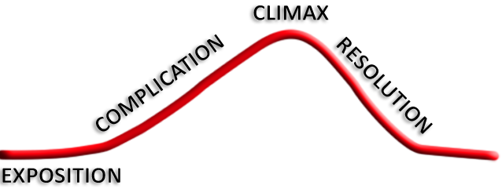
Many people think of it as an arc:

Slide 10
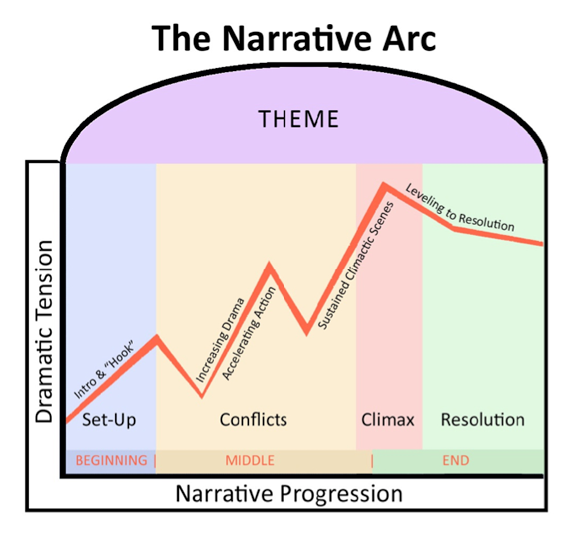
or a bit more involved…

Slide 11
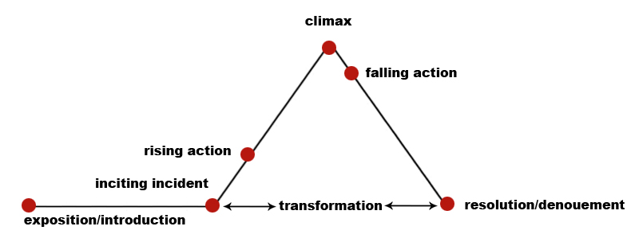
or a triangle…

Slide 12
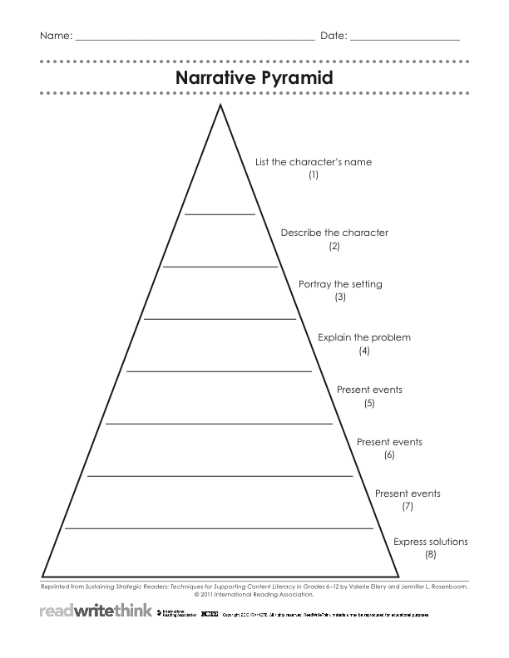
Narrative pyramid

Slide 13
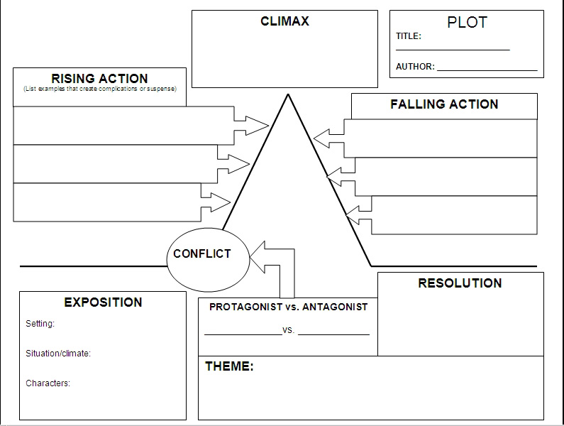
Plot diagram

Slide 14
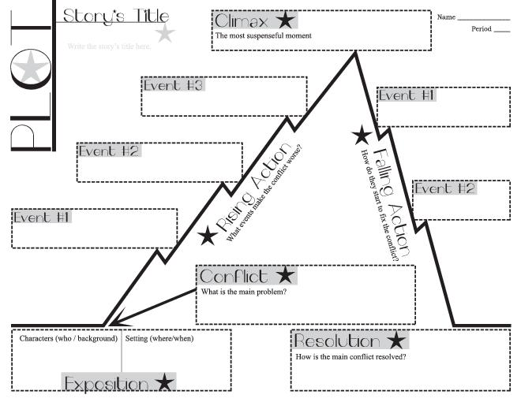
Or this…

Slide 15
Your turn!
Take about 20-30 minutes to think about, talk about, and plan a basic plot for your short story
Remember the problem is the most important and interesting part! Start with that!
Next, we will work on character, setting, sensory details, and transitions.

Slide 16
Character Development
For a short story, maybe one character is enough. Maybe you want two or three. Have ONE MAIN character.
Think about what your character looks like
Think about inner personality traits
How is your character going to deal with the problem?

Slide 17
Tips to create a character:
Tell the reader directly what a character's personality is like:
"Mrs. Freeman could never be brought to admit herself wrong on any point."
—Flannery O'Connor, "Good Country People"

Slide 18
Describe a character's appearance and manner:
"The Baker, who was an older man with a thick neck, listened without saying anything when she told him the child would be eight years old next Monday. The baker wore a white apron that looked like a smock. Straps cut under his arms, went around in back and then to the front again, where they were secured under his heavy waist. He wiped his hands on his apron as he listened to her. He kept his eyes down on the photographs and let her talk."
—Raymond Carver, "A Small, Good Thing"

Slide 19
Portray a character's thoughts and motivations:
"I wanted to call myself Jack, after Jack London. I believed that having his name would charge me with some of the strength and competence inherent in my idea of him. The odds were good that I'd never have to share a classroom with a girl named Jack. And I liked the sound. Jack. Jack Wolff.”
—Tobias Wolff, This Boy's Life

Slide 20
Use dialogue to allow a character's words to reveal something important about his or her nature:
"Unable to contain herself, [Mrs. Bennet] began scolding one of her daughters. 'Don't keep coughing so, Kitty, for heaven's sake! Have a little compassion on my nerves. You tear them to pieces.'”
—Jane Austin, Pride and Prejudice

Slide 21
Use a character's actions to reveal his or her personality:
"He would hang around our place on Saturdays, scornful of whatever I was doing but unable to leave me alone. I couldn't be on the swing without him wanting to try it, and if I wouldn't give it up he came and pushed me so that I went crooked. He teased the dog. He got me into trouble—deliberately and maliciously, it seemed to me afterward—by daring me to do things I wouldn't have thought of on my own: digging up the potatoes to see how big they were when they were still only the size of marbles, and pushing over the stacked firewood to make a pile we could jump off.”
—Alice Munro, "Miles City, Montana"

Slide 22
Show others' reactions to the character or person you're portraying:
"No respect at all was shown him in the department. The porters, far from getting up from their seats when he came in, took no more notice of him than if a simple fly had flown across the reception room.”
—Nikolai Gogol, "The Overcoat"

Slide 23
Give fictional characters meaningful names or use real people's nicknames that relate to their personalities:
Severus Snape—"Severus" means "strict" or "severe" in Latin. Severus Snape is a strict professor who treats Harry harshly.
Sirius Black—"Sirius" is the brightest star in the Canis Major or "Great Dog" constellation. Sirius Black is a wizard who transforms into a black dog.
Peeves—"To peeve" means "to annoy." Peeves is a ghost who pesters people at Hogwart's School.
—J. K. Rowling, Harry Potter series

Slide 24
Setting
Where is it?
When is it?
What is the weather like?
What are the social conditions?
What is the landscape or environment like?
What special details make the setting vivid?

Slide 25
Tips to create a setting
Refer specifically to place and time:
"In the early weeks of 1837, Charles Darwin was a busy young man living in London."
—David Quammen, The Reluctant Mr. Darwin

Slide 26
Describe the inside of a room where a scene takes place:
"The walls were made of dark stone, dimly lit by torches. Empty benches rose on either side of him, but ahead, in the highest benches of all, were many shadowy figures. They had been talking in low voices, but as the heavy door swung closed behind Harry an ominous silence fell.”
—J.K. Rowling, Harry Potter and the Order of the Phoenix

Slide 27
Describe the weather and the natural surroundings:
"And after all the weather was ideal. They could not have had a more perfect day for a garden-party if they had ordered it. Windless, warm, the sky without a cloud. Only the blue was veiled with a haze of light gold, as it is sometimes in early summer. The gardener had been up since dawn, mowing the lawns and sweeping them, until the grass and the dark flat rosettes where the daisy plants had been seemed to shine.”
—Katherine Mansfield, "The Garden-Party"

Slide 28
Weave details about setting into the descriptions of action:
"During the whole of a dull, dark, and soundless day in the autumn of the year, when the clouds hung oppressively low in the heavens, I had been passing alone, on horseback, through a singularly dreary tract of country; and at length found myself, as the shades of the evening drew on, within view of the melancholy House of Usher.”
—Edgar Allan Poe, "The Fall of the House of Usher"

Slide 29
Your turn
Take about 20-30 minutes to think about, talk about, and plan characters and a setting for your short story
Remember to DESCRIBE the characters and setting to make the reader see it!
Next, we will work on sensory details, and transitions.

Slide 30
Make a mind movie!
Imagine the action in the story step by step and add sensory details to make it more exciting. Everything you see in your head should be described on paper for the reader.
What do you see?
What do you hear?
What do you smell?

Slide 31
Example Text: Paragraph Without Sensory Detail
Grandmother Workman reached over and grabbed her grandson’s arm. He was nervous because the staircase was so steep, but she leaned against him and they began to climb.

Slide 32
What do we see now?
Grandmother Workman lurched over and grabbed the pale skin of Randal’s thin forearm with her leathery hand. The folds and creases beneath her skin coiled themselves out like electrical wiring, like the bloated, roughly-textured relief map of the world that his mother just posted above his bedside table. Randal looked ahead toward the winding spiral staircase, fidgeted with a small hole in his baseball jersey, and bit his lip. His mouth filled with the sweet, coppery taste of blood as she leaned in closely toward him, breathing her hot breath on the damp hair at the base of his neck. She smelled of wet cigarettes and bacon. As they slowly climbed the long, steep staircase, the only sound was his grandmothers’ labored breathing and the mournful creak of the wooden stairs.

Slide 33
What do we see now?
Grandmother Workman lurched over and grabbed the pale skin of Randal’s thin forearm with her leathery hand. The folds and creases beneath her skin coiled themselves out like electrical wiring, like the bloated, roughly-textured relief map of the world that his mother just posted above his bedside table. Randal looked ahead toward the winding spiral staircase, fidgeted with a small hole in his baseball jersey, and bit his lip. His mouth filled with the sweet, coppery taste of blood as she leaned in closely toward him, breathing her hot breath on the damp hair at the base of his neck. She smelled of wet cigarettes and bacon. As they slowly climbed the long, steep staircase, the only sound was his grandmothers’ labored breathing and the mournful creak of the wooden stairs.

Slide 34
What do we hear now?
Grandmother Workman lurched over and grabbed the pale skin of Randal’s thin forearm with her leathery hand. The folds and creases beneath her skin coiled themselves out like electrical wiring, like the bloated, roughly-textured relief map of the world that his mother just posted above his bedside table. Randal looked ahead toward the winding spiral staircase, fidgeted with a small hole in his baseball jersey, and bit his lip. His mouth filled with the sweet, coppery taste of blood as she leaned in closely toward him, breathing her hot breath on the damp hair at the base of his neck. She smelled of wet cigarettes and bacon. As they slowly climbed the long, steep staircase, the only sound was his grandmothers’ labored breathing and the mournful creak of the wooden stairs.

Slide 35
What do we hear now?
Grandmother Workman lurched over and grabbed the pale skin of Randal’s thin forearm with her leathery hand. The folds and creases beneath her skin coiled themselves out like electrical wiring, like the bloated, roughly-textured relief map of the world that his mother just posted above his bedside table. Randal looked ahead toward the winding spiral staircase, fidgeted with a small hole in his baseball jersey, and bit his lip. His mouth filled with the sweet, coppery taste of blood as she leaned in closely toward him, breathing her hot breath on the damp hair at the base of his neck. She smelled of wet cigarettes and bacon. As they slowly climbed the long, steep staircase, the only sound was his grandmothers’ labored breathing and the mournful creak of the wooden stairs.

Slide 36
What do we smell now?
Grandmother Workman lurched over and grabbed the pale skin of Randal’s thin forearm with her leathery hand. The folds and creases beneath her skin coiled themselves out like electrical wiring, like the bloated, roughly-textured relief map of the world that his mother just posted above his bedside table. Randal looked ahead toward the winding spiral staircase, fidgeted with a small hole in his baseball jersey, and bit his lip. His mouth filled with the sweet, coppery taste of blood as she leaned in closely toward him, breathing her hot breath on the damp hair at the base of his neck. She smelled of wet cigarettes and bacon. As they slowly climbed the long, steep staircase, the only sound was his grandmothers’ labored breathing and the mournful creak of the wooden stairs.

Slide 37
What do we smell now?
Grandmother Workman lurched over and grabbed the pale skin of Randal’s thin forearm with her leathery hand. The folds and creases beneath her skin coiled themselves out like electrical wiring, like the bloated, roughly-textured relief map of the world that his mother just posted above his bedside table. Randal looked ahead toward the winding spiral staircase, fidgeted with a small hole in his baseball jersey, and bit his lip. His mouth filled with the sweet, coppery taste of blood as she leaned in closely toward him, breathing her hot breath on the damp hair at the base of his neck. She smelled of wet cigarettes and bacon. As they slowly climbed the long, steep staircase, the only sound was his grandmothers’ labored breathing and the mournful creak of the wooden stairs.

Slide 38
What do we feel now?
Grandmother Workman lurched over and grabbed the pale skin of Randal’s thin forearm with her leathery hand. The folds and creases beneath her skin coiled themselves out like electrical wiring, like the bloated, roughly-textured relief map of the world that his mother just posted above his bedside table. Randal looked ahead toward the winding spiral staircase, fidgeted with a small hole in his baseball jersey, and bit his lip. His mouth filled with the sweet, coppery taste of blood as she leaned in closely toward him, breathing her hot breath on the damp hair at the base of his neck. She smelled of wet cigarettes and bacon. As they slowly climbed the long, steep staircase, the only sound was his grandmothers’ labored breathing and the mournful creak of the wooden stairs.

Slide 39
What do we feel now?
Grandmother Workman lurched over and grabbed the pale skin of Randal’s thin forearm with her leathery hand. The folds and creases beneath her skin coiled themselves out like electrical wiring, like the bloated, roughly-textured relief map of the world that his mother just posted above his bedside table. Randal looked ahead toward the winding spiral staircase, fidgeted with a small hole in his baseball jersey, and bit his lip. His mouth filled with the sweet, coppery taste of blood as she leaned in closely toward him, breathing her hot breath on the damp hair at the base of his neck. She smelled of wet cigarettes and bacon. As they slowly climbed the long, steep staircase, the only sound was his grandmothers’ labored breathing and the mournful creak of the wooden stairs.

Slide 40
What do we taste now?
Grandmother Workman lurched over and grabbed the pale skin of Randal’s thin forearm with her leathery hand. The folds and creases beneath her skin coiled themselves out like electrical wiring, like the bloated, roughly-textured relief map of the world that his mother just posted above his bedside table. Randal looked ahead toward the winding spiral staircase, fidgeted with a small hole in his baseball jersey, and bit his lip. His mouth filled with the sweet, coppery taste of blood as she leaned in closely toward him, breathing her hot breath on the damp hair at the base of his neck. She smelled of wet cigarettes and bacon. As they slowly climbed the long, steep staircase, the only sound was his grandmothers’ labored breathing and the mournful creak of the wooden stairs.

Slide 41
What do we taste now?
Grandmother Workman lurched over and grabbed the pale skin of Randal’s thin forearm with her leathery hand. The folds and creases beneath her skin coiled themselves out like electrical wiring, like the bloated, roughly-textured relief map of the world that his mother just posted above his bedside table. Randal looked ahead toward the winding spiral staircase, fidgeted with a small hole in his baseball jersey, and bit his lip. His mouth filled with the sweet, coppery taste of blood as she leaned in closely toward him, breathing her hot breath on the damp hair at the base of his neck. She smelled of wet cigarettes and bacon. As they slowly climbed the long, steep staircase, the only sound was his grandmothers’ labored breathing and the mournful creak of the wooden stairs.

Slide 42
Transitions

Slide 43
Review
Genre
Story elements- plot (problem and solution), characters, setting
Sensory details
Transitions
Dialouge

