Slide 1
Pronunciation Workshop: vowels, their rules and their exceptions Kimberly kern, English language fellow IHCI, 2013 kern.kimika@gmail.com
Kimberlykern.weebly.com

Slide 2
Warm-Up Tongue Twisters!
red leather, yellow leather

Slide 3
The sixth sick sheik's sixth sheep's sick

Slide 4
According to MIT researchers, the most difficult phrase to spit out is:
pad kid poured curd pulled cod

Slide 5
Pronunciation Poem
Brush Up On Your English
http://www.wordsmith.org/awad/english2.html
You will each get a part of the poem to look over. It is difficult! Don’t worry, try your best!

Slide 6
Now,
that we have loosened up our mouths, it’s time to begin!
There are many many things to focus on in English pronunciation. You wanted a review of vowels!
The main vowels are…….. A, E, I, O, U, Y
But first……

Slide 7
The Schwa
A schwa sound can be represented by any vowel.
The schwa is the vowel sound in many lightly pronounced unaccented syllables in words of more than one syllable. It is sometimes signified by the pronunciation "uh" or symbolized by ə.
The a is schwa in adept or a pencil.
The e is schwa in synthesis.
The i is schwa in decimal.
The o is schwa in harmony.
The u is schwa in medium.
The y is schwa in syringe.

Slide 8
Which vowel is the schwa?
Encyclopidia
Excellent
Banana
Experiment

Slide 9
American vs. British Schwa
The schwa is WAY more common in British English
The best example is –er
How many brothers and sisters have you got?
How many brothers and sisters do you have?

Slide 10
A
Short sound
Cat
Rat
Caberet
vary
Long sound- silent e
Plate
State
Scrape

Slide 11
E
Short sound
Bed
Kettle
Net
Friend
Merry
Long sound- silent e
Peter

Slide 12
I
Short sound
Knit
Fit
Clip
Long sound-silent e
Size
Fries
white

Slide 13
O
Short sound
Box
Rocks
block
Long sound- silent e
Pole
Stole
go
cold
Told
old

Slide 14
U
Short sound
Bug
button
Gun
glove
Long sound- silent e
Tube
Cube
Use

Slide 15
Y
As long I
Fly
Why
Shy
As long e
Happy
Really
Sadly

Slide 16
Pronunciation Grid

Slide 17
Lip Posture

Slide 18
English vowel teams
 |  | ie | ia | io
ei | ey | ee | ea | eo | eu | ew
ai | ay |  |  |  | au | aw
oi | oy | oe | oa | oo | ou | ow
ui | uy | ue
regular
irregular
regular rule

Slide 19
ie
Middle- long e
Feirce
Feind
Chief
Two syllables-dipthong
Diet
quiet
Final- long I
Die
Pie
lie

Slide 20
ea
Long e
Sea
Team
Read
Long a
Break
great
Short e
Spread
Dead
Read

Slide 21
ou
Regular “ow”
House
Thousand
Out/ ouch
After y- long u
You
Youth
your
Short u
Double
Trouble
Couple
Long u
Soup
group
Exception-soul

Slide 22
ow
“oh” long o sound
Snow
Know
Own
Bow
Tower
“ow” like house
Brown
Down
Clown
Bow
Tower

Slide 23
oo
Long u sound
Boot
Soon
Mood
School
Short u sound
Flood
Blood
Foot
Before d/k- short round u
Good
Book
Look
wood

Slide 24
ee
Long e sound
Tree
Meet
Seen
Beetle
Exception- short i
Been
Exception- long a
(French words)
Entrée
Fiancee
Nee

Slide 25
oa
Long o sound
Boat
Goat
Groan
Toast
Exception- “aw”
Broad
Dipthongs
Boa
Coagulate
Coaxial
Noah

Slide 26
oe
Long o sound
Toe
Doe
roe
Exception- long u
shoe

Slide 27
ai/ay
Middle- long a sound
Paid
Maid
Rain
Sailor
Final- long a sound
Pay
May
Play
Stay
Exception- short e
Said
again

Slide 28
oi/oy- dipthong
Middle
Oil
Coin
Spoil
Final
Soy
Royal
boy
Exception- French
croissant

Slide 29
ui
Long u sound
Suit
Juice
friut
Short i sound
Built
Guild
Building
Dipthong
ruin

Slide 30
uy
Long i sound
Buy
Try
Guy
buyer

Slide 31
ue
Long u sound
True
Blue
glue
Exceptions
Guess
Vague
League
rogue

Slide 32
eu/ew
Long u sound
Neuter
Pneumonia
Blew
Few
New
Exception- sew

Slide 33
au/aw
Pronounced like “awwwww” (something cute!)
Caught
Taught
Lawn
Hawk
Saw
Gnaw
Craw

Slide 34
eo
After g- Dipthong
Geography
Geology
Before r- “or”
George
Georgia

Slide 35
ei/ey
After c- long e sound
Receive
Receipt
Deceive
Final- long a
They
Grey
Prey
Before gh- long a
Their
Neighbor
Weigh
Exception- long e
Weird

Slide 36
ia/io/ious
Stressed long a, schwa
Bias
Dial
Diary
Riot
Stressed long e, short a
Maniac
Radial
Radiant
Serious
Various

Slide 37
igh
Long i sound
Light
Bright
Night
Sight
Sigh
thigh

Slide 38
tion/sion
Pronounced as “shun”
Invitation
Compassion
Graduation
Initiation
Passion

Slide 39
R-controlled vowels
er, ur, ir- same sound like “grrrrr”
Sister
Baker
Birthday
Girl
Curly
hurl
ar- “arrrr” like a pirate
Car
Star
Parkinglot
or- like the Oreo cookies
Floor
More
Orphan

Slide 40
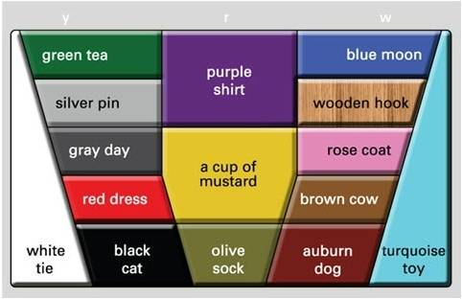
The Color Vowel Chart is a teaching tool to help students focus on the stressed vowel in the stressed syllable. It represents the 15 vowel sounds in American English with two key words: a color adjective and a noun. You can find this online at www.colorvowelchart.org

Slide 41
So, how can we teach this?
Slowly over time! Don’t bombard your students like I bombarded you!
Maybe one vowel team a day?
Teach if you hear they are having a particular problem.
Answer questions students have.
But, definitely directly teach the basic vowels and the two different sounds for each!

Slide 42
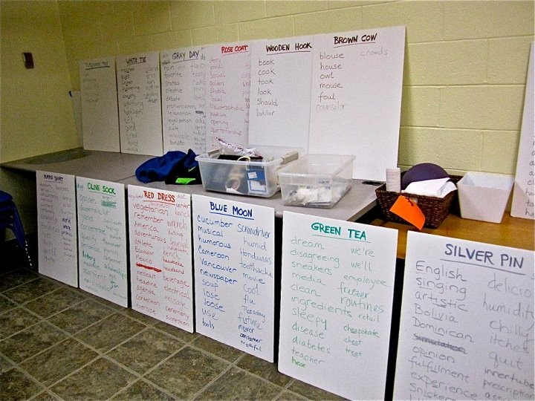

Slide 43
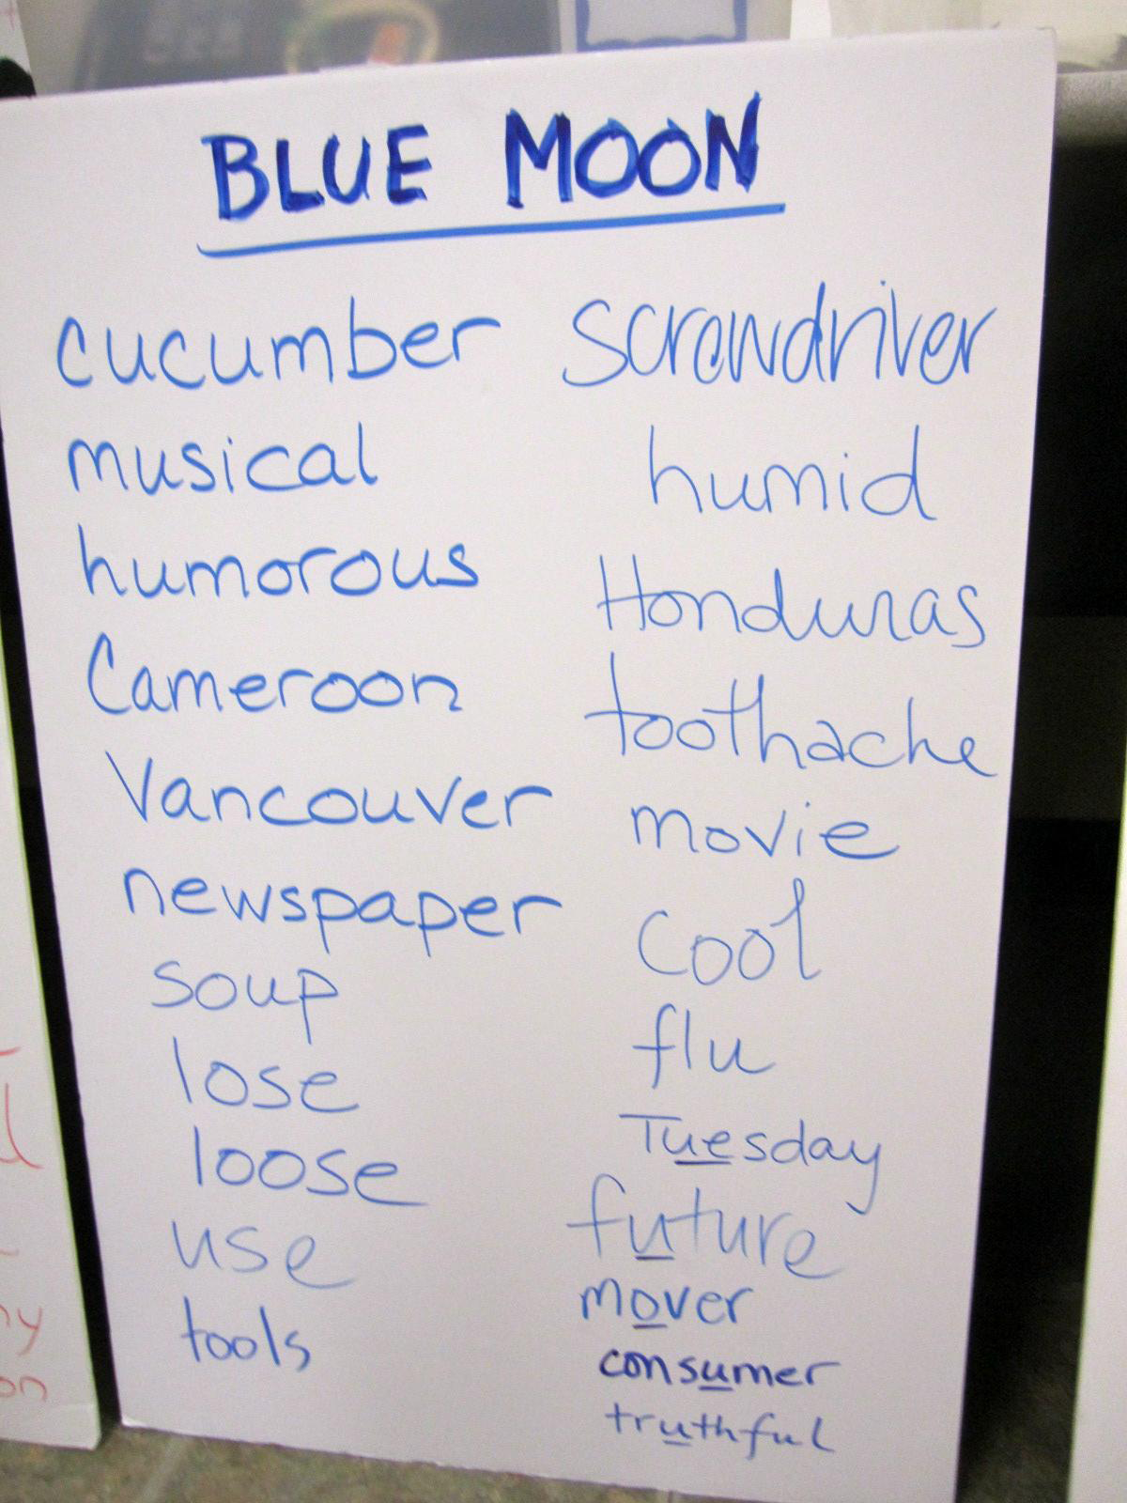

Slide 44
Categorizing activity!
Take a handful of cards and categorize them. You can use the Color Vowel Chart or short and long vowel sounds to make different piles
Work with a partner!

Slide 45
The Color Vowel Chart is a teaching tool to help students focus on the stressed vowel in the stressed syllable. It represents the 15 vowel sounds in American English with two key words: a color adjective and a noun. You can find this online at www.colorvowelchart.org

Slide 46
Color Vowel Word Lists
Each student receives a word list
Teacher dictates words and students identify where the word goes on the grid. They then underline the stressed syllable.
Ex. Peaches goes in Green Tea

Slide 47
Color Sounds of the Alphabet
Low levels- teach the vowel sounds with the alphabet

Slide 48
Color Vowel Gallery
Use color-printed pages to make a gallery of color words along with other words to help students remember new vocabulary and important pronunciation of words!
colorvowelchart.org

Slide 49
Teaching Pronunciation Strategies
Listen and repeat
Isolation- of phonems (sounds)
Minimal pairs- rat/rate Tim/time will/while
Record and replay
Use a mirror to see mouth.
Use the phonetic alphabet- do you know it?
Show a vowel diagram/grid
Sing! It’s also lots of fun!
Tounge twisters
Target specific trouble sounds

Slide 50
That’s all folks!
Thanks for your attention! There is lots more to discuss of pronunciation, but for another day!
Have a great Christmas and a Happy New Year!
kimberlykern.weebly.com

