Slide 1
ESL Warm-ups and Ice breakers
Kimberly Kern
English Language Fellow
IHCI
kern.kimika@gmail.com

Slide 2
Two Truths and a Lie
This is my personal favorite ice breaker and warm-up! Each student says three sentences about themselves. Everyone guesses the lie!
You can use any verb tense with this to review what you are studying. Have students choose their own or choose for them.
Can be used for beginners- advanced
Can be used over and over!

Slide 3
My sentences (always model first)
I have two big brothers named Chris and Scott.
I was born in Texas, but have been living in NYC for the past 6 years.
One of my favorite things to do is dance.

Slide 4
Why have warm-ups?
Students who arrive on time to class receive extra attention and practice
It’s a good way to review from the previous day
Get students thinking and interacting in English before the lesson.
It´s fun!
All these ideas I have learned from the web, other teachers, and books! I know there are MANY, MANY more, so please share your wonderful ideas.

Slide 5
Warm-Ups For Any Level
Dictations- make it about something fun! Running dictation!
How Many Sounds Can You Hear?- sit for two minutes and listen. Longest list wins.
Make the Most Words- groups of 2-3. Longest list wins.
Eg. Apologize, dictionary, September

Slide 6
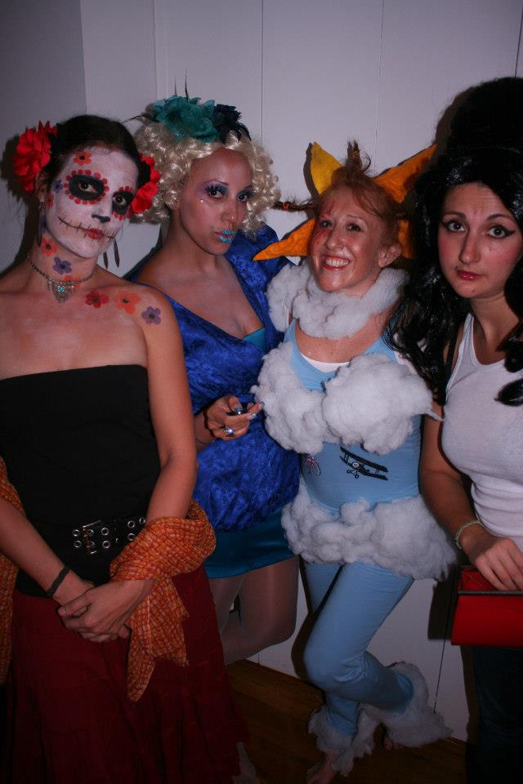
Write 8 sentences with adjectives about the picture

Slide 7
Toungue twisters
Sally sells seashells down by the sea shore.
Say that 3 times fast!

Slide 8
Toungue twisters
Fuzzy Wuzzy was a bear. Fuzzy Wuzzy had no hair. Fuzzy Wuzzy wasn´t very fuzzy was he?
Say that 3 times fast!

Slide 9
Whats wrong?
Mary has 20 years old.
Mario is a person which is very intelligent.
Kayla knows a lot of persons.
Marta has two childrens.

Slide 10
Any Level
Memory Circle- any vocabulary, any tense, good for drilling, everyone remembers the people who went before.
Eg. I went on vacation and I….
Everyday I ……
Next year I will…..
In my bag I have a ….. (he has…., she has….)
Hot Potato- pass around a ball or paper with questions. When the music stops, that student must do something.

Slide 11
Disappearing act
I love to celebrate Halloween because I dance to Micheal Jackson´s Thriller in the NYC Halloween parade.

Slide 12
Disappearing act
I love to __________ Halloween because I dance to Micheal Jackson´s Thriller in the NYC Halloween parade.

Slide 13
Disappearing act
I love to __________ Halloween because I dance to Micheal Jackson´s Thriller __ the NYC Halloween parade.

Slide 14
Disappearing act
I love to __________ Halloween because I dance __ Micheal Jackson´s Thriller __ the NYC Halloween parade.

Slide 15
Disappearing act
I ____ to __________ Halloween because I dance __ Micheal Jackson´s Thriller __ the NYC Halloween parade.

Slide 16
Confusing sentence
Sister my chocolate like doesn´t.
Champions friends are the we my.

Slide 17
Any level
Verb cards:practice pronunciation!- students put cards in piles or lines that have ¨t¨ ending, ¨d¨ending, or ëd¨ending
Verb cards: create a story! Go around the circle and use at least one verb, turn verbs over when they have been used
TPR- Total Physical Response with any verb!

Slide 18
Riddles
What´s black and white and red all over?
What´s black and white and read all over?

Slide 19
Any Level
Idioms!- teach and practice one a day!
Eg. Easy as pie, or It´s a piece of cake.
Gallery Walk- students look at pictures and pick one that speaks to them, then they tell the class why.
Why did you pick your picture?

Slide 20
Warm-ups for Beginners
Picture Games- good for drilling basic sentences.
Eg. 16 women
Hangman- good for alphabet and vocabuary
Survey/graph- simple question, students talk about the graph. Comparatives!
How many siblings do you have? Complete the graph.
Telephone Game

Slide 21
Warm-ups for Intermediate
Name Ten! Get students to think of ten items that fit a certain criteria.
Eg: jobs where you have to wear a uniform
English football clubs
sports that are played with a ball
foods that contain egg
animals that lay eggs
three letter parts of the body (eye, arm, leg, hip, ear, toe jaw, rib, lip, gum)
What am I Up To? Read the list of materials and wait for someone to shout out the correct activity in present continuous.
Eg:1. couch, friends, DVD, popcorn, soda
2. soil, hose, shovel, watering can, seeds
3. basket, grapes, blanket, sandwiches, Frisbee
4. milk, bowl, spoon, toaster, cereal
5. soap, bucket, sponge, car, hose
6. table, box, all of the pieces, time, patience
7. night light, child, glasses, lap, book
8. coat, thread, needle, scissors, button
9. bag, scale, scoop, jelly beans, pen, label
10. house, ladder, nails or hooks, helper, bright lights

Slide 22
Intermediate
I´m Going to My Grandmother´s House-
Start with a,b,c then go around and remember what everyone said. Helps with fluency. Can be used with different tenses and vocabulary.
Eg. I go to my Grandmother´s house and I always take…
I went to my grandmother´s house and I took…
Harry goes to his grandmother´s house and he always takes…
I go shopping and I always buy…

Slide 23
Warm-ups for Advanced
Just-a-Minute Students get a category and have to describe all 8 words in a minute.
Role Plays students can work together to plan the role play or just be spontaneous!
20 questions- animal, vegetable, or mineral. Give a list of helpful questions.
Read a poem- and discuss
Comic Strips- students fill in dialogue
www.eslthemes.com/comic_writing/strips

Slide 24
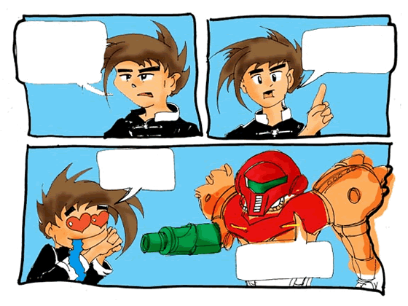
Fill in the comic strip

Slide 25
Fill in the comic strip

Slide 26
Ice breakers
5 similarities, 5 differences- in groups, students ask questions to find 5 things they have done and 5 things they haven´t. (present perfect.)
My name is? -Go around the group and ask each student to say his/her name and attach an adjective that starts with the same letter of his name e.g. generous Grahame, dynamic Dave. Write them down and refer to them by this for the rest of the evening. (adjectives)
Desert Island - 'You've been exiled to a deserted island for a year! You may take one piece of music, one book (which is not the Bible) and one luxury item you can carry with you i.e. not a boat to leave the island! What would you take and why?' (conditional)

Slide 27
Ice breakers
I have never….. - students sit in a circle. Someone in the middle says I have never…. If you have done that thing, you have to move seats. This is fun!! (present perfect)
Line up – Ask students to line up. Works best with 8-10 in a line. If you’ve got a bigger group, split them up and challenge each line to complete the task first. Ask the group to form a new line in order of….
• Height, from smallest to tallest.
• Birthdays, from January through to December.
• Shoe size, from smallest to largest.
• Alphabetical first names (A-Z).
• Alphabetical mothers first names.
• Alphabetical grandmother's first names!
• Anything else you think up.

Slide 28
Ice breakers
Would you rather..? Questions may range from silly trivia to more serious content. On the way you might find out some interesting things about your young people! Place a line of tape down the centre of the room. Ask the group to straddle the tape.
Would you rather..?
• Visit the doctor or the dentist?
• Eat broccoli or carrots?
• Watch TV or listen to music?
• Own a lizard or a snake?
• Have a beach holiday or a mountain holiday?
• Be an apple or a banana?
• Be invisible or be able to read minds?
• Be hairy all over or completely bald?
• Be the most popular or the smartest person you know?
• Make headlines for saving somebody's life or winning a Nobel Prize?
• Go without television or fast food for the rest of your life?

Slide 29
Ice breakers
4 C's - 4-6 people per team (10-15 minutes) Each person writes down on an index card his/her favorite: Color, Cuisine, Country to visit and Closet Dream. The cards are shuffled and redistributed. Each person reads aloud the card they picked up and each person guesses in writing who wrote it. At the end, see who guessed the most correct responses.

Slide 30
Ice breakers
The human chair - Invite everyone to stand in a circle shoulder to shoulder. Each person then turns to the right to face the back of the person in front of them. On the count of three they slowly begin to sit down on the lap of the person behind. As long as everyone is helping the person in front of him or her to sit, then everyone should be supporting the weight of everyone else. Of course, should someone slip, the game becomes 'human dominoes.' ☺ It might take a couple of attempts to complete the challenge.
Who wants to try???

